Slide 1
Circulation

Slide 2
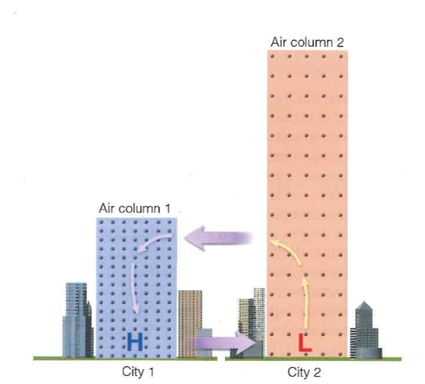
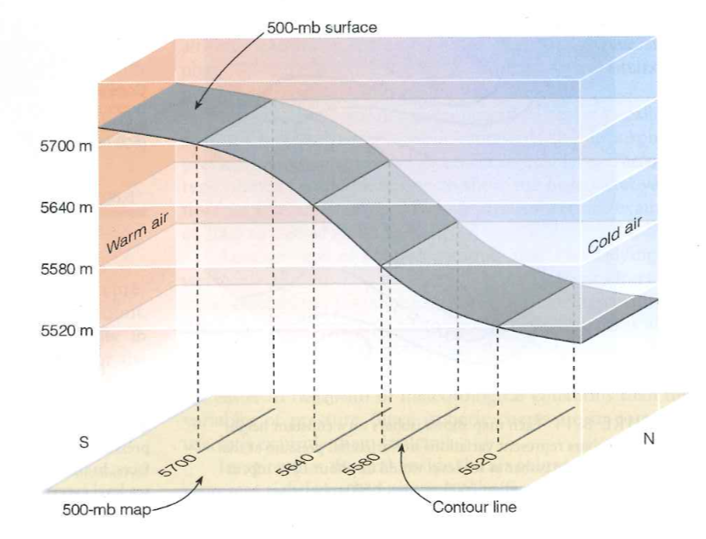
Pressure Gradient Forces

Slide 3
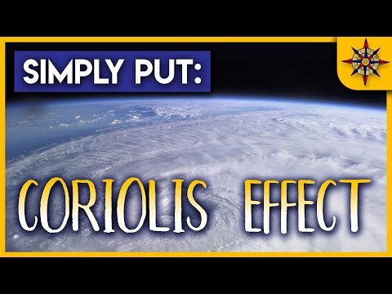
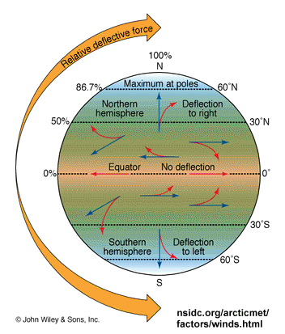
Coriolis Effect

Slide 4
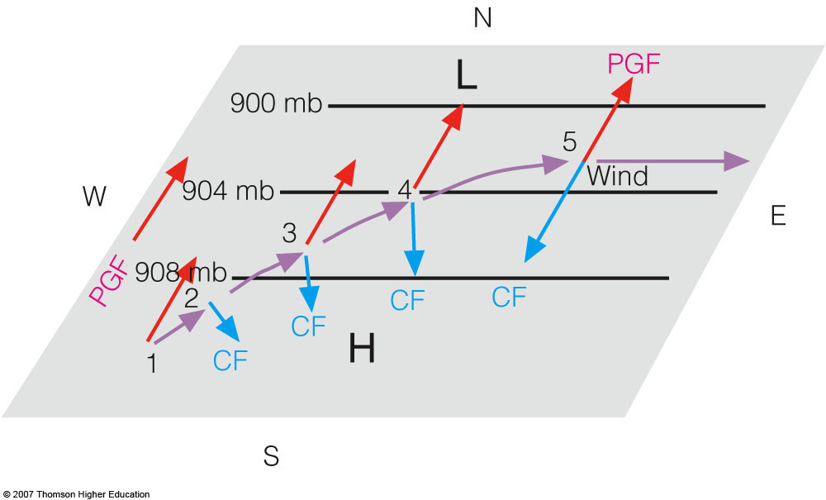
Geostrophic Balance
Pressure Gradient Force = Coriolis Effect

Slide 5
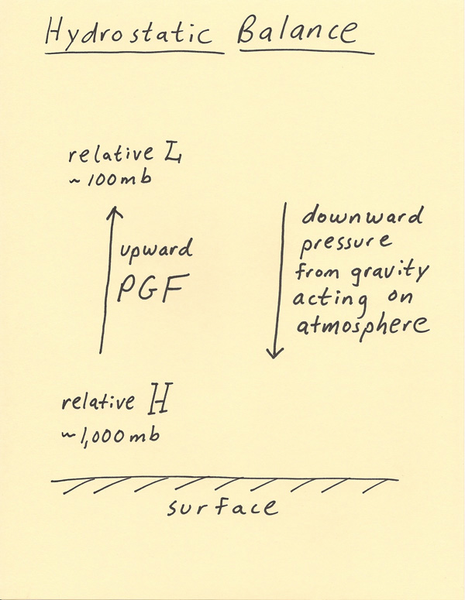
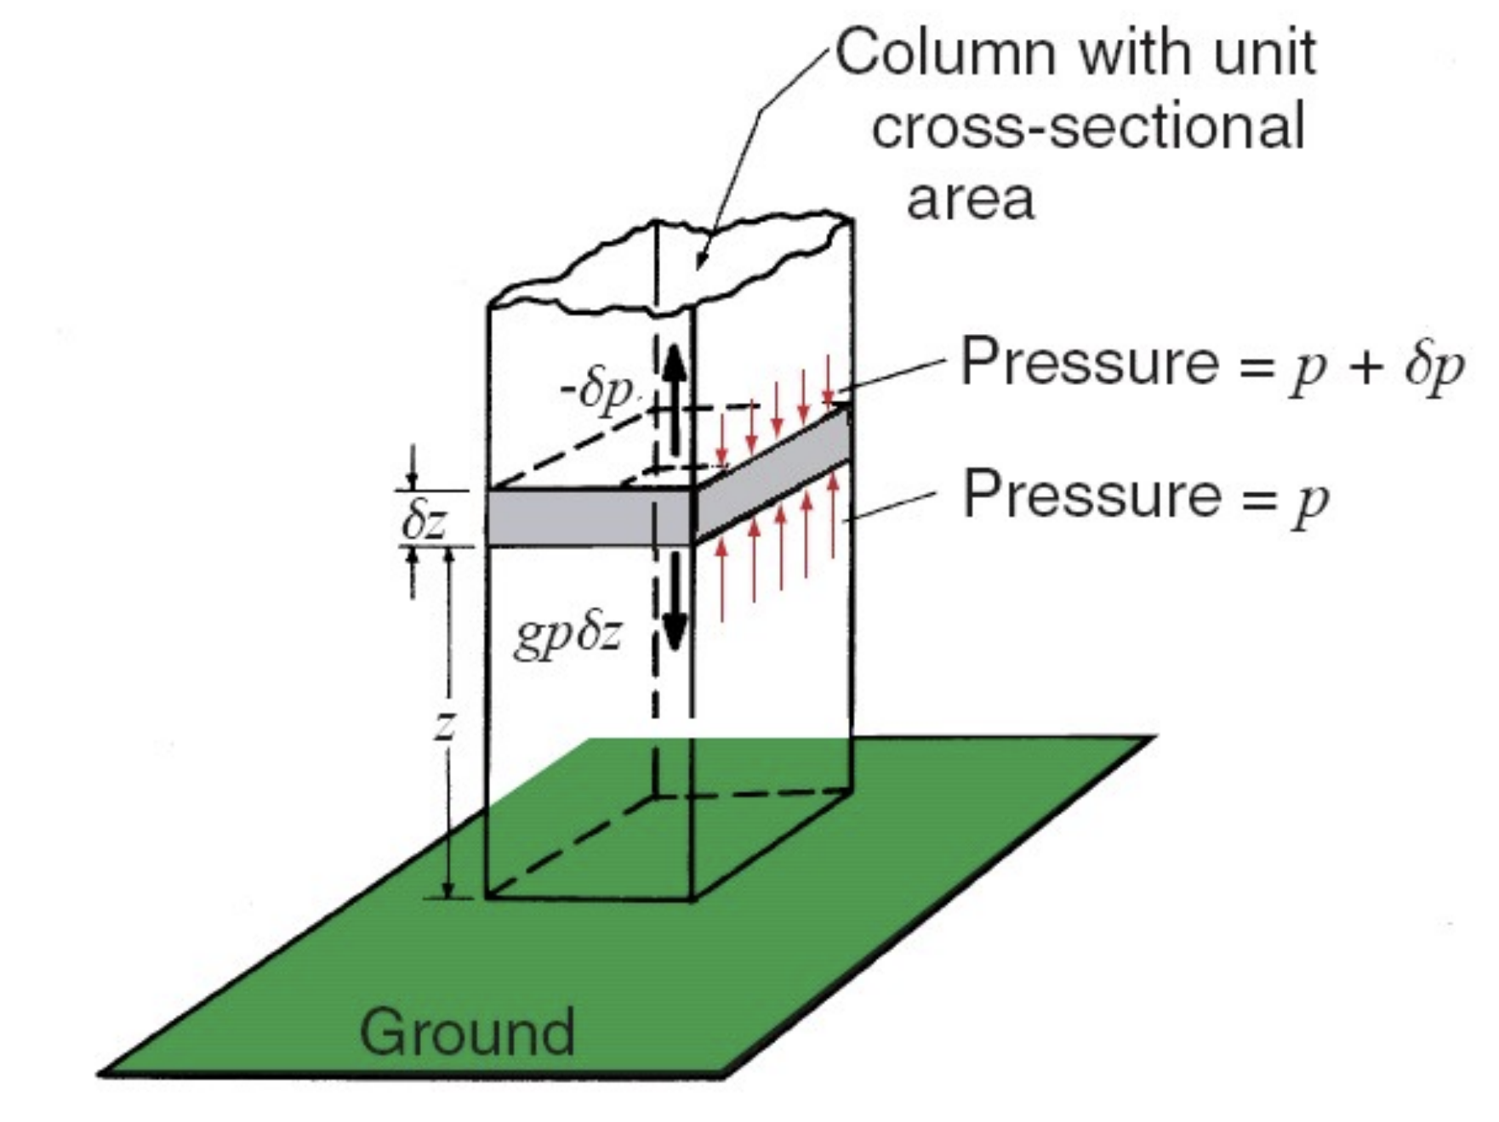
Hydrostatic Balance

Slide 6
GPGP papers
https://www.theoceancleanup.com/technology/

Slide 7
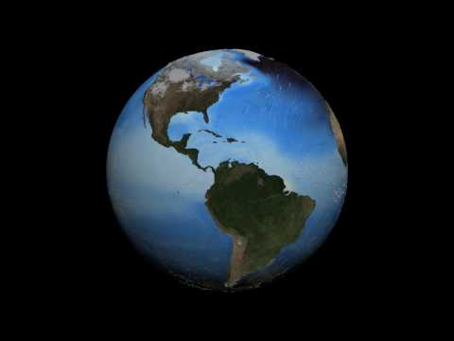
AMOC papers

